Slide 1
Indian Knowledge System for
Human Culture and Civilisation

Slide 2

Indian Knowledge System
India developed its knowledge system, tested it through practice, verified and improved it over thousands of years
As a result, the Indian Knowledge System is founded on
the ‘wellbeing of all’
सर्वे भवन्तु सुखिनः सर्वे सन्तु निरामयाः
वसुधैव कुटुम्बकम्
एकम् सत् विप्रा बहुधा वदन्ति
कृण्वंतो विश्वं आर्यं
It is based on a deep understanding of human being
as well as of nature and entire existence

Slide 3
Human Effort has always been for
Living (surviving)
  Physical facility
Living with fulfilment
  Relationship and
  Physical facility
Living with continuous fulfilment
(called by different names such as bliss, peace, satisfaction, happiness, fulfilment, contentment, enlightenment, independence, self-actualisation, ecstasy, divinity, salvation, liberation, ,…)
  Right understanding (understanding harmony – truth)
  Living in harmony (love and compassion)
    Relationship (living in harmony with human being) and
    Physical facility (ensuring more than required, but in harmony with rest of nature with right skills)

Slide 4
Effort for Realisation of Truth, Love & Compassion
All great people of the world have tried to realise the truth
and to live by it in terms of love and compassion
They have tried to realise the Truth
    Understand themselves (human being)
    Understand the underlying harmony in nature, in existence
    and on the basis of this understanding
2. They have tried to develop a way of life, culture and civilisation for the wellbeing of all (living with love and compassion)
For all such great people, we have a deep feeling of gratitude…

Slide 5
Culture, Civilisation
Understanding or Assumptions
Culture The collective thought
Civilisation Expression in the form of behaviour and societal system
Over the ages, various cultures and civilisations have taken shape. At the core of the civilisation is its culture; and the base of the culture is what has been understood or assumed (without understanding) about the existential reality i.e. truth, love and compassion.
A civilisation is the expression of a culture in the form of behaviour and societal system.
In order to share our understanding, feelings and thoughts, various means of communication have been used such as – language, literature, song, dance, drama, painting, sculpture…
To materialise this culture in terms of behaviour and system, different forms have been developed such as science, technology, architecture, modes of production, transportation, exchange, modes of education…

Slide 6
Holistic and Humane Knowledge System
A knowledge system which ensures right understanding and clarity of living in harmony at all levels of human existence can be called a holistic and humane knowledge system
Many cultures and civilisations over millennia have tried to evolve such knowledge systems
एकम् सत् विप्रा बहुधा वदन्ति
The Indian culture and civilisation is one such example
How a culture, civilisation develops and is propagated generation after generation depends on its education-sanskar, its knowledge system

Slide 7
Conduct, Culture and Civilisation… through Education-Sanskar
Human education-sanskar Inhuman education-sanskar
(मानवीय शिक्षा-संस्कार) (अमानवीय शिक्षा-संस्कार)
Humane world view, perspective Inhumane world view, perspective
(मानवीय दृष्टि) (अमानवीय दृष्टि)
Human values, culture inhuman values, culture
(मानवीय मूल्य, संस्कृति) (अमानवीय मूल्य, संस्कृति)
Human conduct – behavior, work, participation Inhuman conduct – behavior, work, participation
(मानवीय आचरण – व्यवहार, कार्य, व्यवस्था में भागीदारी) (अमानवीय आचरण – व्यवहार, कार्य, व्य. में भागीदारी)
Human society, culture, civilisation Inhuman society, culture, civilisation
(मानवीय समाज व व्यवस्था, (अमानवीय समाज, अव्यवस्था,
मानवीय संस्कृति, सभ्यता) अमानवीय संस्कृति, सभ्यता)

Slide 8
Holistic Education
Human education-sanskar (मानवीय शिक्षा-संस्कार)
Humane world view, perspective Main part of education
(मानवीय दृष्टि) 1. Universal
2. Rational
Human values, human culture 3. Verifiable
(मानवीय मूल्य, मानवीय संस्कृति) 4. Leading to Harmony
+
Skills for living in harmony Value guided skills
(व्यवस्था पूर्वक जीने के लिए हुनर)
Human society, human culture, civilisation
(मानवीय समाज व व्यवस्था, मानवीय संस्कृति, सभ्यता)

Slide 9
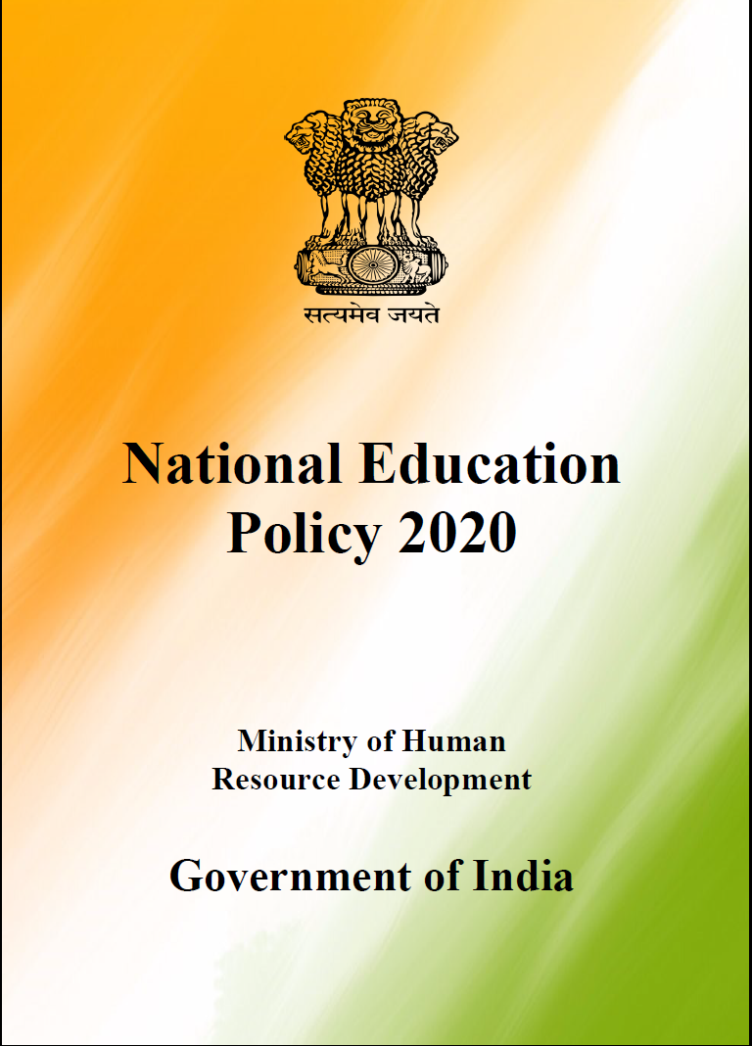
Aspirations in National Education Policy 2020
Education is fundamental for achieving
        full human potential,
        developing an equitable and just society,
        and promoting national development
(See page 3)
We have to understand the meaning of
  Full human potential
  Equitable and just society
  National development
Source: https://www.mhrd.gov.in/sites/upload_files/mhrd/files/NEP_Final_English.pdf p3

Slide 10
Holistic Education
Human education-sanskar (मानवीय शिक्षा-संस्कार)
Humane world view, perspective
(मानवीय दृष्टि)
Human values, human culture Full human potential
(मानवीय मूल्य)
Skills for living in harmony, with joy
(व्यवस्था पूर्वक, उत्सव पूर्वक जीने के लिए हुनर)
Graduates will be able to contribute to a human society
Human society, human culture, human civilisation
(मानवीय समाज व व्यवस्था An equitable and just
मानवीय संस्कृति, सभ्यता) society
National development

Slide 11
The Problem and a Solution
The world today has become a mixture of various cultures.
In India, we can see
  Urban / City culture  Western culture
  Liberal culture  “Bollywood” culture
  Traditional rural Indian culture
  and so many others
Today, the problem is that one culture tends to be opposed to other cultures. This is because their basic assumptions and therefore thoughts are different. Even though there are commonalities at the core, the conflict is at the level of expression and details.
With this situation, it is imperative to
  Articulate the truth, love and compassion at the core
  Appreciate the various ways to materialise this truth, love and compassion and , different approaches to communicate this truth, love and compassion to others.

Slide 12
Formulation for Education
It is desirable to have generic and universal formulation, content and process – universal, basic or fundamental principles. Of course, to exemplify these, local, regional examples may be taken and will be taken.
  For example: We want to live with fulfilment as a society. This part is common, universal.
  To exemplify this, we may expose students to traditional Indian culture and philosophy as well as traditional western culture and thought.
In this way,
  It will help in understanding the underlying basic principles
  It will help in connecting the basic principles through specific examples
  It will help the student to see and appreciate various cultures, to see the commonality amongst them
  It will help to evaluate any specific example, system or culture, with a view to fill the gaps, rather than to criticise or reject it. Further, we can also be mutually enriching for other cultures.

Slide 13
An Important Point to keep in mind
It is important to have a universal formulation
If we don’t have a universal formulation, there is no definite yardstick for evaluation
It is likely that people think that their formulation, their culture, content, practice etc. is superior and the others are not
There is not only no common program to live together in harmony, rather there is opposition and strife in the society, which may lead to struggle and even war

Slide 14
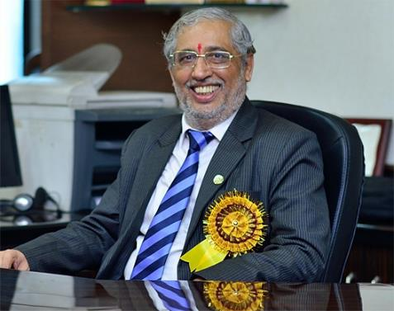
AICTE Model Curriculum
In March 2017, AICTE decided to update its Model Curriculum from the 2018-19 academic year for all technical education (engineering, architecture etc.) across India:
  Mandatory 3-week Student Induction Program
  UHV is to be offered as an essential 3-credit course (UHV-II or H-102) in 3rd/4th semester or earlier
Today, more than 10,000 colleges under the AICTE umbrella are preparing their teachers for this huge task of National importance

Slide 15

Tangible efforts for Human Values in Technical Education
Policy
Induction Program Cell (IPC) at AICTE
SIP (UHV-I) and UHV-II in Model Curriculum
Approval Process Handbook 2020-21 (pp 164 and 310)
Enablement
3-day FDP-SI throughout the year (for orientation)
8-day FDPs during the summer and winter break
(AICTE will bear the cost of boarding and lodging of participants)
AICTE will provide certificates to successful participants
(such faculty members may teach UHV-I and UHV-II)
Recognition
AICTE will duly recognise efforts in this direction by
Individual faculty members
Colleges and
Universities
This is an initial, but significant step in value-based education for value-based living,
which includes
sustainable (planet-friendly) technology and
humane (people-friendly) management practices
Steps for preparing faculty for these programs
will be outlined on the last day

Slide 16
Indian Knowledge System – Holistic and Humane
India developed its knowledge system, tested it through practice, verified and improved it over thousands of years
As a result, the Indian Knowledge System is founded on the ‘wellbeing of all’ and is based on a deep understanding of human being as well as of nature and entire existence,
It seems to satisfy the requirement of a holistic and humane knowledge system

Slide 17
Indian Knowledge System…
It is in this context that we may look into the Indian Knowledge System, taking some specific examples, and try to see it in the perspective of a holistic and humane system of knowledge
The specific examples may help teachers and students, in connecting to the basic principles and also relate them to their day to day life
This approach may also help the participants, in the long run to
  Appreciate the knowledge systems developed by various cultures and civilisations, including the Indian Knowledge System
  See the commonality amongst the knowledge systems developed by various cultures and civilisations
कृण्वंतो विश्वं आर्यं
Participants should be able to develop a view of filling any gaps, of being mutually enriching, rather than to criticise or reject any knowledge system

Slide 18
We look forward to your active participation…
We trust it will help in further refining your view about this AICTE effort
Best Wishes!
Dr. Rajneesh Arora
Chairperson, National Coordination Committee for Induction Program
(NCC-IP)

